Slide 1
Credit Card Approval Prediction
Kaggle - Data Science competition

Slide 2
Objective
Apply machine learning to help predict future default credit of clients.
Problem Statement:
Two data sets contain information about clients and their history of credit, with the help of supervised learning we need to predict the default before applying. Except this time data is not labeled and it’s unbalanced. Also one user may apply multiple times.

Slide 3
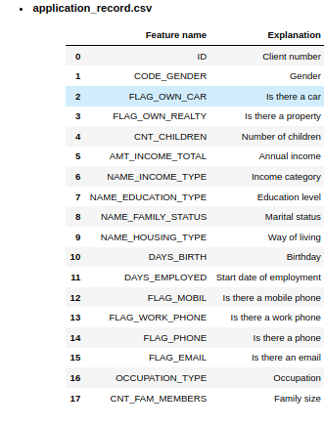
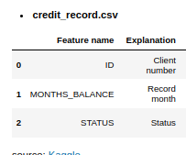
Viewing and understanding Data

Slide 4
Data structuration
credit_record.csv
application_record.csv
ID1
ID2
ID3
ID1
ID2
ID3
User 1
ID1
ID2
ID1
ID2
User 2
User 3
ID1
ID2
.
.
.
ID1
ID1
User n
ID1
User x

Slide 5
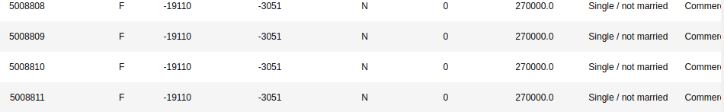
Example of multiple application by user
Example 1:
Example 2:
Example 3:

Slide 6
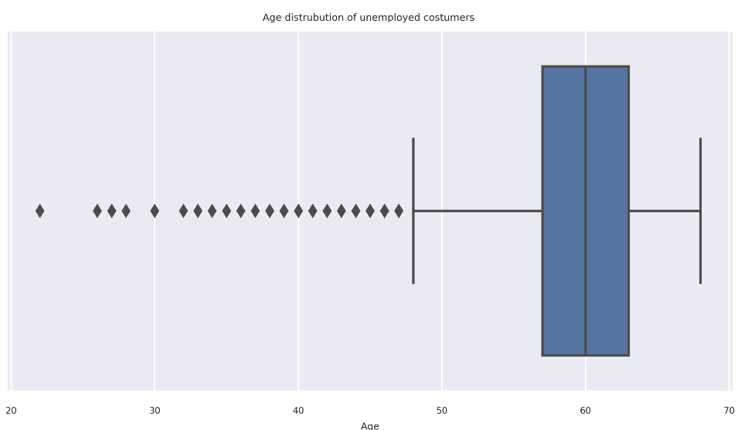
Missing Data
Lucky for us we didn’t have missing data even for OCCUPATION_TYPE variable, it turned out it was pensioners as shown in graph bellow.
This explain why this category have annual income without having a job

Slide 7
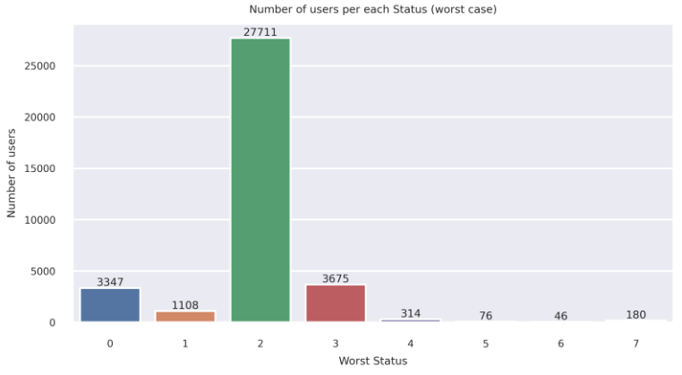
Data Labeling
The plot on the left shows that users that had at most Status 2 (-29 days past due) represent ~ 88 % of our dataset.
And in case we consider that Status 3 is good debt then we will have ~ 98%.
For our case we went with with 98 % good debt because status 2 and 3 are still considered past due and not overdue.
for our sake of understanding it's better to change the status based on the risk level for example:
- 0 will represent STATUS C and X since they won't represent risk.
- 1 will represent the current STATUS 0
- etc..

Slide 8
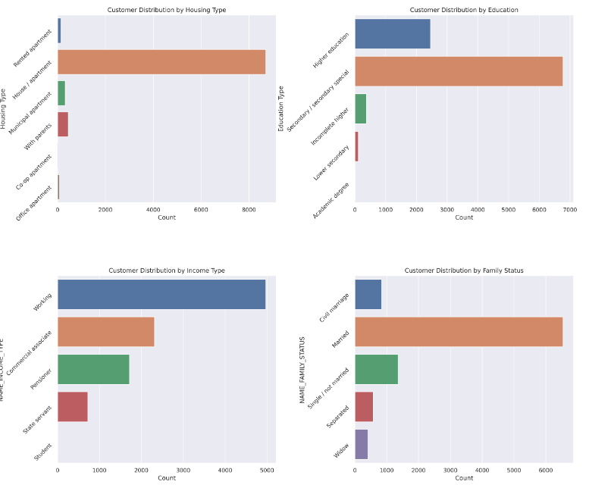
Bar plots on represent the different categories of population
variance for both variables Housing Type and Name Family status are low.

Slide 9
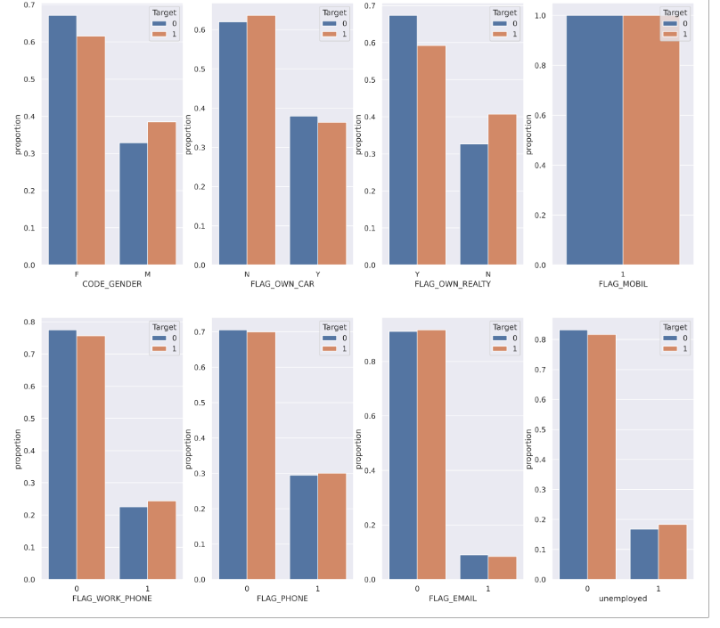
Target 0 : STATUS 0,1,2,3
Target 1 : STATUS 4,5,6,7
We see here that FLAG mobil and Flag Email doesn't introduce any information to our data set especially Flag mobil it's flat.

Slide 10
Feature engineering
Creating new feature in bothe data sets.
Applications record:
House holde: number of entire family
Avergae income per person
Transform days since birth to years
Transform days employed to months
Categorical encoding : mean, one_hot, hashing
Total life income.
Credit record:
Month opened account.
Last known Flaged months (if Status >3)
Number of opened account
Number of active account

Slide 11
Handling data leakage
To ensure that we didn’t introduce any leakage in credit record data set we had to make sure that we only take data prior to every application.
Month 10
ID 1234
C | X | C | 1 | 1 | 1
ID 1212
1 | 3 | 1 | c | c | c
User 234
ID 1213
c | x | 2
Group | ID | Flaged | Active | Open Month | Opened | Zeros
234 | 1234 | 0 | 1 | 10 | 1 | 0
234 | 1212 | 0 | 2 | 13 | 2 | 3
234 | 1213 | 1 | 2 | 16 | 3 | 5

Slide 12
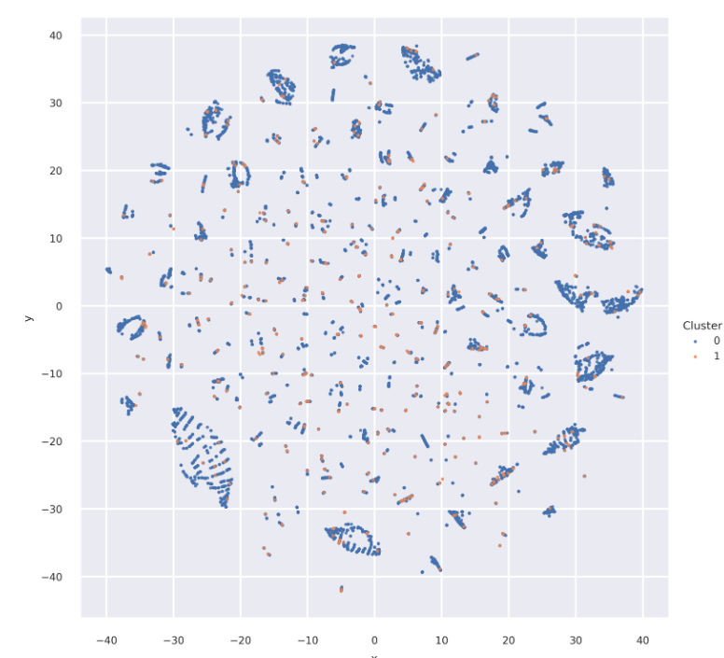
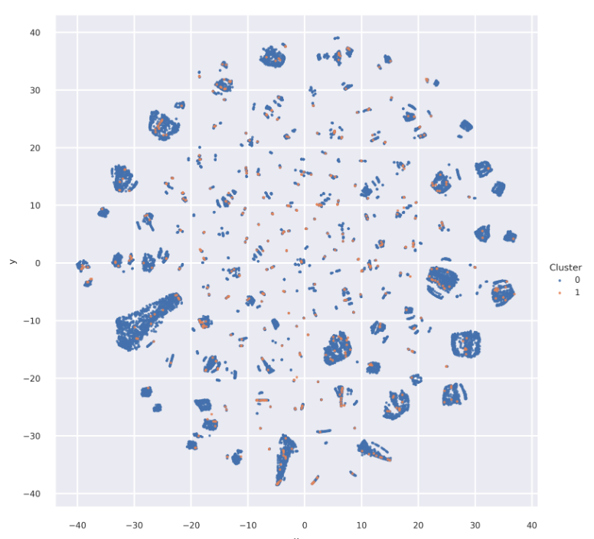
dimension reduction
The plot on the left we applied TSNE only on application record
And on the right we added credit record.

Slide 13
Modeling:
Before applying ML models we had to do some steps:
Train test split
Data balancing using SMOTE algorithm (over sampling)
Scaling X_train
Once that done, we created different classifiers:
LogisticRegression
KNeighbors
DecisionTree
RandomForest
XGBoost
CatBoost
We manually tunned the models.

Slide 14
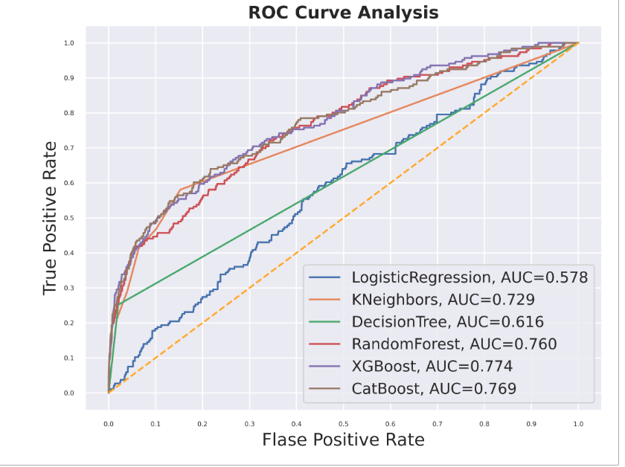
The results of confusion matrix are in the notebook.

Slide 15
Recommendations
If I had a little bit more time I would do theses extra steps:
New Variables by applying clustering algorithms.
Remove outliers or cut the max and the mean
Use different method of scaling (log for example)
Apply different algorithm for balancing (under sampling, both)
Use Bayesian optimization for hyper parameters
Introduce new variable in credit record (detail type of flag etc.)
I also might use time series to predict in credit report and use it as input for new data set.

